Slide 1

NAVIGATING THE DANGER
Threat zone of an explosion particularly in oil and gas handling industries or refineries

Slide 2
PROBLEM STATEMENT
Find Out Threat zone of an explosion particularly in oil and gas handling industries or refineries

Slide 3
INTRODUCTION
In the world of oil and gas industries and refineries, safety is the most important thing. People can get hurt, things can break, the environment can get messed up, and it can cost a lot of money. The "threat zone" of an explosion is like the danger area around it. It's not just the place where the explosion goes off, but also how far its effects can reach. Lots of things, like the type of materials, how much of them there are, and how the place is built, can make the danger zone bigger or smaller. To keep these places safe, we need to study explosions more closely, figure out how risky they are, and come up with good ways to keep them from happening or making them less harmful. This way, we can make sure that the people who work in these places and the people who live nearby are safe.

Slide 4
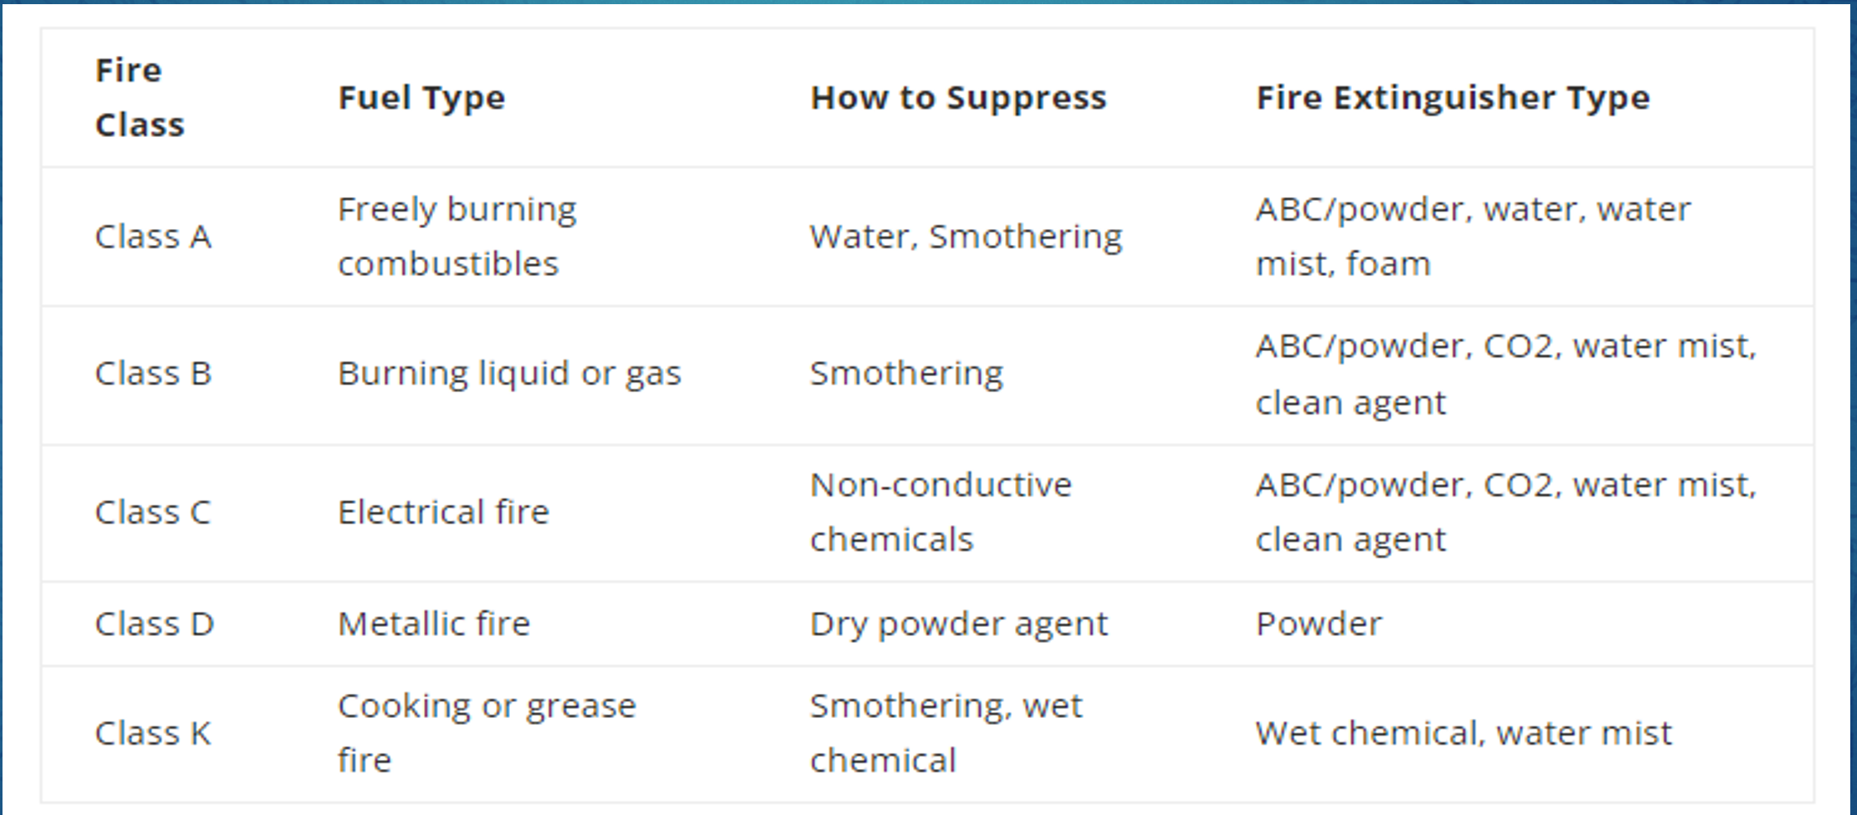
TYPES OF FIRE AND EXTINGUISHERS

Slide 5
OBJECTIVES
Develop algorithms and models to accurately identify and delineate hazardous zones for various types of storage and potential threats, distinguishing between areas with different radiation levels and risks to human life, property, and the environment.
Implement algorithms to assess radiation levels in real-time, categorizing areas as very high, high, medium, or low radiation zones, enabling safe and strategic deployment of personnel and equipment.
Create a system that optimizes the allocation of firefighting and emergency response resources by providing real-time recommendations on the best approach and direction of attack to minimize risks to responders and maximize efficiency.

Slide 6
METHODOLOGY
Once a fire is detected, flame sensors determine the presence of fire or flame. It works using infrared flame flash technology.
This sensing relies on variables such as humidity and temperature.
Based on the radiation in a fire accident or blast, we can easily detect the threat zone with the help of GMR.
This GMR is connected to the computer.
It sends signals to vision cameras to detect height and patterns of fire with the help of deep learning.
We collect the dataset of CCTV containing fire scenarios, including different types of fires, lighting conditions and potential sources of false alarms.
Later we preprocessed the collected data, including tasks such as frame extraction, image enhancement, noise reduction and standardization.
After preprocessing we made image and video analysis and machine learning algorithms for fire detection such as convolutional neural networks (CNNs) and deep learning.
Later, divide the dataset into training, validation and testing sets. We trained the above selected algorithms using the training data and optimize the goals of automatic fire suppression system.

Slide 7
Integrate the fire detection algorithm with the automatic fire dousing mechanisms such as sprinkler systems or fire extinguishers. At last, validation and testing is done in our project with a good accuracy and efficiency.
Once a fire is detected, the camera captures an image of the fire and sends it to an Android application over a wireless network with the help of a microcontroller.
It sends a message to the fire services and nearby rescue services.
When the temperature rises, the temperature sensor will detect and trigger the buzzer, and the buzzer will sound to alert the people over there who are living near the threat zone.
The fire extinguisher pump is connected to the IC.
If a flame is detected, the IC activates the DC motor and fire extinguisher pump.
Sprinklers attached to the pumps spray the extinguishing agent over the entire area affected by the fire.
Even if the fire doesn’t suppressed by the sprinklers in our industry, it sends an immediate message to the fire services.

Slide 8
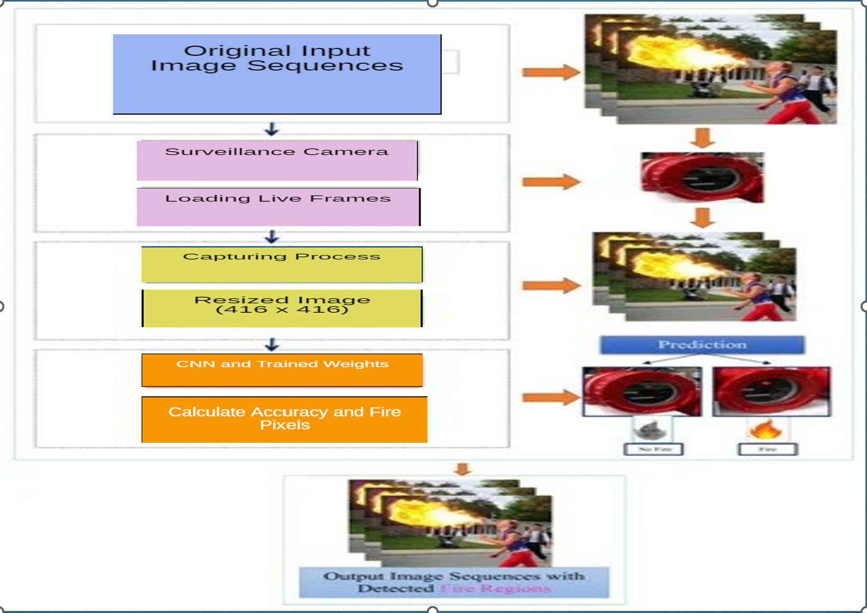
RECOGNIZING THE FIRE PATTERNS

Slide 9
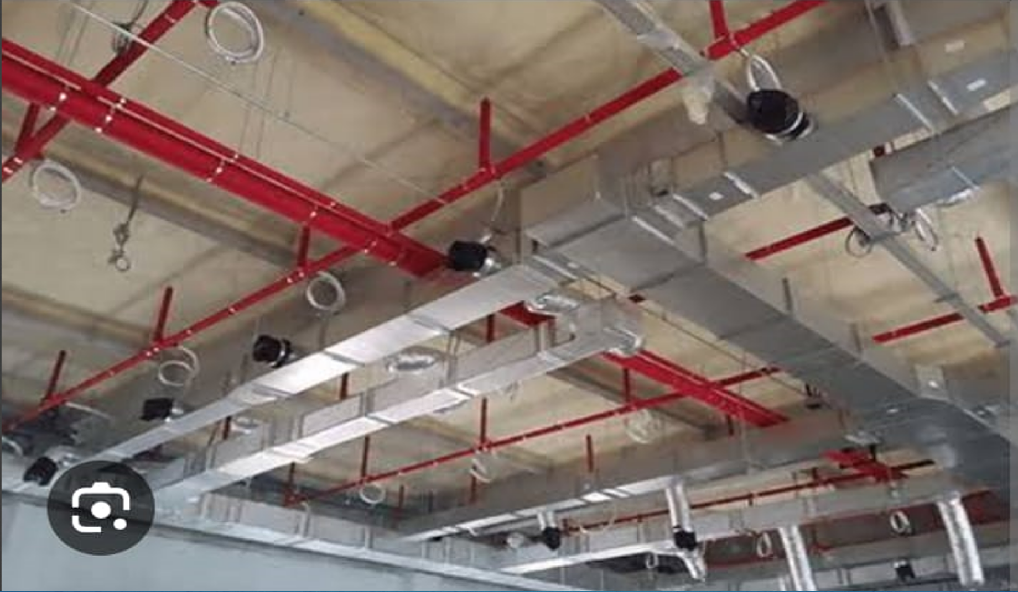
INSTALLATIONS OF EXTINGUISHERS

Slide 10
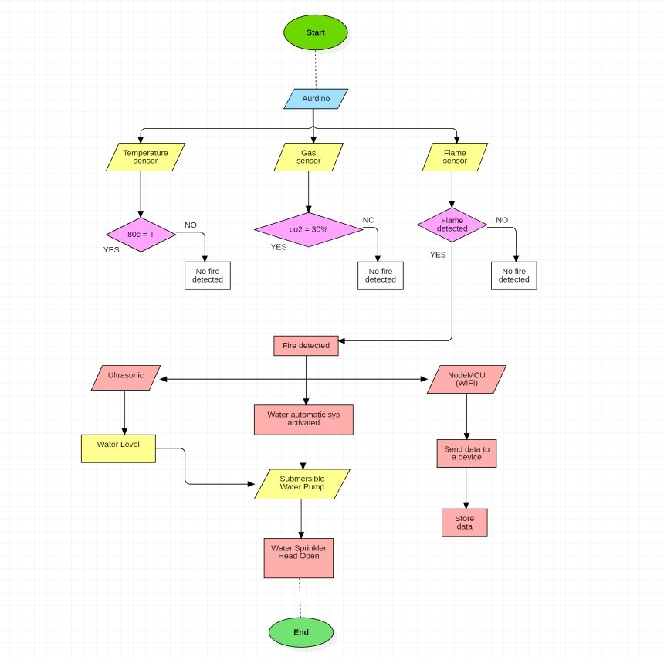
SYSTEM DESIGN

Slide 11
TECHNOLOGY STACK
The main technology stack for addressing explosion threat zones in oil and gas handling industries and refineries typically includes:
Sensor Technology:
Gas detectors
Flame detectors
Temperature and pressure sensors
Deep Learning and Machine Learning:
ML algorithms for predictive analytics and early warning systems.
CNN, RCNN, Fast CNN, Faster CNN.

Slide 12
3. Data Analysis and Monitoring:
Data analytics software.
4. IoT (Internet of Things)
Sensors are connected to IoT.
4. Emergency Response Systems:
Alarm systems
Evacuation and emergency communication systems

Slide 13
CONCLUSION
Development of this software will help a lot to our fire services to tackle any type of explosion and fire scenarios with more efficiency. We can evacuate people and animals from areas with disastrous exposure to radiation, so that more and more lives can be saved until the fire will be extinguished or under control.

Slide 14
THANK YOU!

